Slide 1


HIDING MESSAGE IN AN IMAGE
STEGNOGRAPHY

Slide 2

STUDENT DETAILS:
Name: Kanne Bharath
Skillsbuild ID:bharathkanne9989@gmail.com
College Name: Holy Mary Institute Of Technology And Science
College State: Telangana
Internship Domain: Cyber Security
Internship Start/End Date: 20/10/23 – 17/11/23
Candid Photo

Slide 3
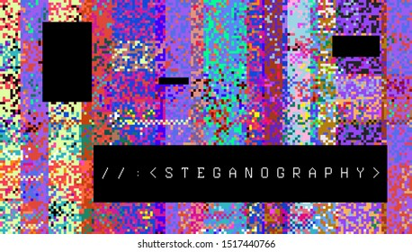
Project TOPIC:
STEGNOGRAPHY
Hiding data in image also known as image steganography is a technique user to conceal sensitive or confidential information within digital images.
The process involves embedding the data within the pics of an image, making it appear as a normal image to the human end, the hidden data can be any form of digital information, such as text files or other multimedia content.

Slide 4
AGENDA
Understanding Steganography Techniques
Perform Image Manipulation,
Processing.
Understanding About Data Encryption And Security.
Implementing image Steganography
Implementing Image Steganography
Understanding Steganography Techniques

Slide 5
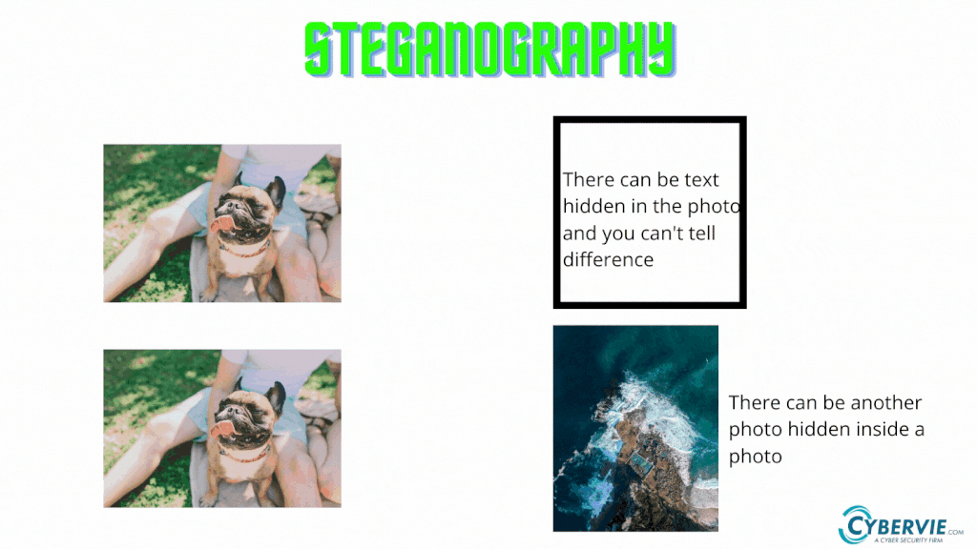
Project overview
Steganography is the art and science of concealing information within seemingly innocuous data. It is a form of information security that focuses on hiding data in plain sight, making it challenging for unauthorized individuals to detect the presence of concealed information. Steganography techniques have a wide range of applications, from securing sensitive information to digital watermarking, copyright protection, and even forensics.
Steganography can be used in four different ways:
1.Using text
2.Image Steganography 3.Audio Steganography
4.Vedio Steganography
5.Network Steganography

Slide 6


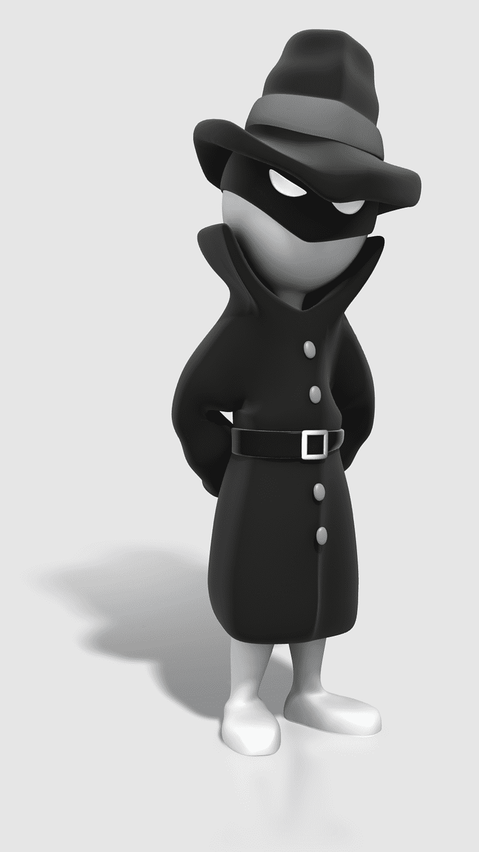
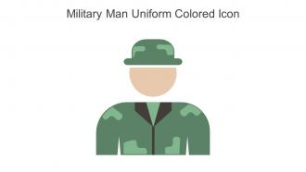

End users
Steganography can be used both for constructive and destructive purposes. For example, education and business institutions, intelligence agencies, the military, and certified ethical hackers use steganography to embed confidential messages and information in plain sight.

Slide 7
Your solution and value proposition:
Steganography provides a unique and robust method for securing data.
The project's steganography tools offer individuals and organizations the means to maintain their privacy.
Steganography can be applied to protect digital content like images, audio, and video from unauthorized copying and distribution.
The development of user-friendly steganography software tools ensures that individuals without advanced technical knowledge can easily hide and extract data from digital media.
Steganography can enable more secure and efficient data transfer, particularly in scenarios where traditional encryption methods may be cumbersome or less effective
The project opens doors to explore advanced steganography techniques and their potential applications in emerging technologies, including blockchain, IoT, and more.

Slide 8

customization
Combining Python with a Graphical User Interface (GUI) for a steganography project streamlines the process of concealing data within digital media. Python's versatility and rich libraries make it an ideal choice for implementing steganography techniques. The GUI enhances user interaction by allowing intuitive cover image selection, secret data input, and encoding/decoding operations. This combination simplifies data hiding while promoting ethical usage. It offers a user-friendly, accessible, and secure approach to secure communication and data protection. The project can be a valuable asset for individuals, content creators, and organizations looking to safeguard their information and intellectual property.

Slide 9
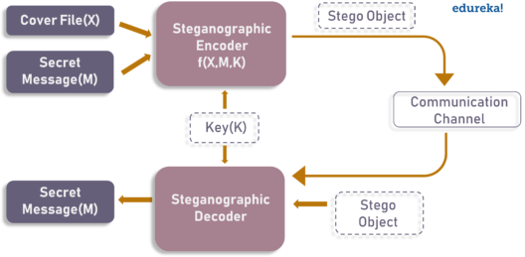
modelling
Basic steganographic model

Slide 10
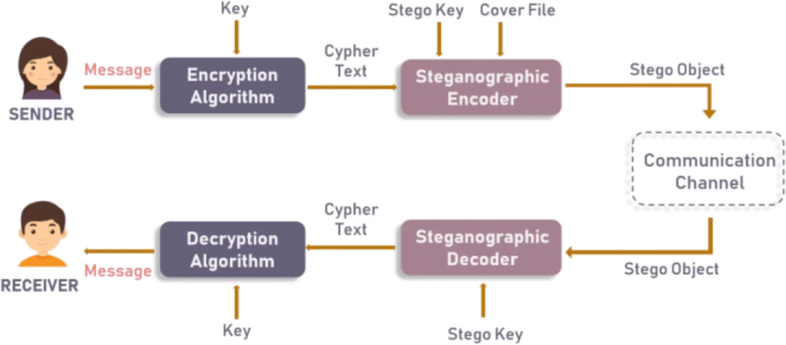
Steganographic model with encryption

Slide 11
Encryption algorithm:
import cv2
import os
import string
img = cv2.imread(r"C:\Users\bhara.KBHARATH\Desktop\stego\me.jpg")
if img is None:
print("Error: Image not found.")
exit()
msg = input("Enter secert message")
password = input("Enter password")
d={}
c={}
for i in range(255):
d[chr(i)]=i
c[i] = chr(i)
m=0
n=0
z=0
for i in range(len(msg)):
img[n,m,z] = d[msg[i]]
n=n+1
m=m+1
z=(z+1)%3
cv2.imwrite("Encryptedmsg.jpg",img)
os.system("start Encryptedmsg.jpg")

Slide 12
Decryption algorithm:
message =""
n=0
m=0
z=0
pas = input("Enter passcode for Decryption")
if password == pas:
for i in range(len(msg)):
message = message + c[img[n,m,z]]
n=n+1
m=m+1
z=(z+1) % 3
print("Decryption message",message)
else:
print("Not valid key")

Slide 13
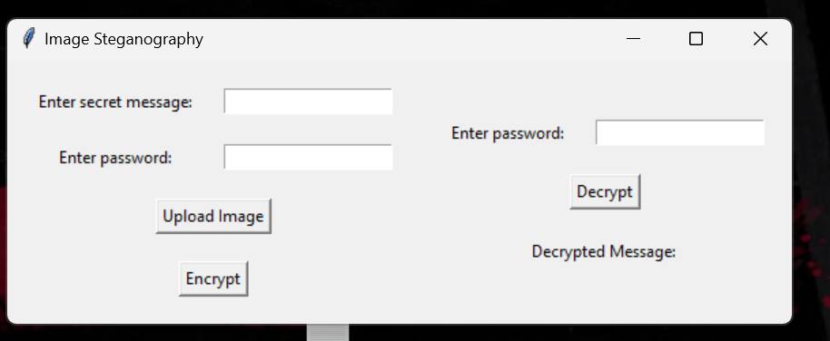
Images:
Gui interface

Slide 14
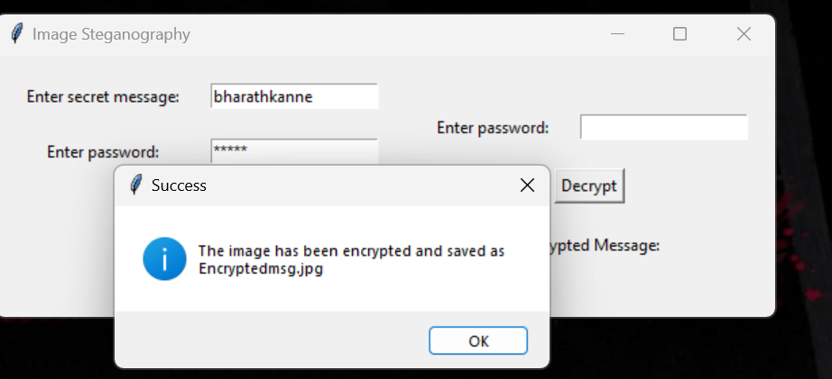
After encoding:

Slide 15
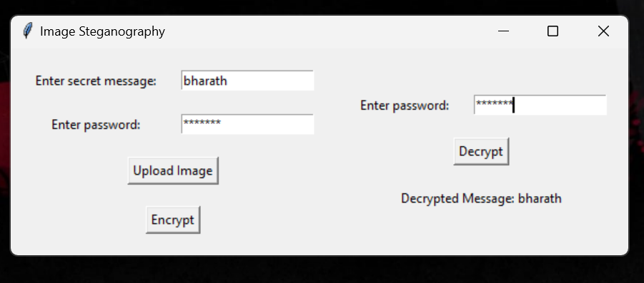
After decoding:

Slide 16
Result:
Users can easily select source files, customize embedding options, and extract hidden data.
Users have the flexibility to customize their data embedding process, including adjusting the level of data embedding, employing encryption, and adding password protection.
Extensive testing has been conducted to evaluate the security and robustness of the steganography techniques.
The project has educational value by helping users gain a better understanding of steganography techniques, ethical considerations, and data security. It can serve as a valuable learning tool for individuals interested in the field.
The project's design allows for future enhancements, such as exploring advanced steganography techniques, integrating with emerging technologies, and extending the toolkit's capabilities, keeping it at the forefront of innovation.
In summary, the Steganography Toolkit with GUI Interface project has successfully delivered a user-friendly, versatile, and secure tool for data concealment and extraction. It emphasizes ethical use and offers educational value, positioning it as a valuable resource in the field of information security and steganography.

Slide 17
Links:
https://github.com/bharathkanne/steganography-hiding-mssg-in-image-.git

Slide 18
THANK YOU

